Slide 1


Project Milestone 7
Final Presentation
Machine Learning Model for Customer Eligibility Assessment
GROUP D
Christian, Mokgadi, Delight, Omphile

Slide 2
Executive Summary
Project Aim: Develop an intelligent model for assessing customer eligibility for satellite internet services, addressing limitations in the traditional salary-based evaluation system.
Key Achievements:
Developed a Random Forest-based eligibility model with an accuracy of 99.99%.
Integrated the model with LangaSat’s CRM, delivering real-time assessments.
Streamlined and automated eligibility assessments, saving time and reducing operational costs.
Business Impact: Improved service delivery, consistent eligibility assessments, enhanced customer satisfaction, and operational efficiency.

Slide 3

Introduction
Project Background:
LangaSat, a provider of satellite internet services, traditionally determined customer eligibility based solely on annual salary. Recognizing this as insufficient, the company sought a more comprehensive, data-driven approach.
Problem Statement:
The current salary-only assessment method lacked depth, leading to potential inaccuracies and missed opportunities in customer eligibility evaluation.
Project Scope:
Develop a machine learning model that integrates various financial and demographic variables to enhance eligibility assessment accuracy
Objectives:
Build a high-performing eligibility model using a Random Forest algorithm
Integrate the model into LangaSat’s business systems for real-time operation.
Maintain ethical handling of customer data throughout the project.

Slide 4
Business Understanding
Business Objectives:
Improve eligibility assessment accuracy by using additional predictive variables.
Enhance operational efficiency by reducing manual assessments.
Increase customer satisfaction through faster, consistent service delivery
Success Criteria:
Business success is defined by improved decision-making speed, customer satisfaction scores, and operational cost savings.
Data Mining Goals:
Develop a predictive model that accurately identifies eligible customers.
Achieve high model performance, with metrics such as accuracy, precision, and recall exceeding 95%.
Project Team Organization:
Team Structure:
A collaborative team of business intelligence students.
Roles: Each member contributed to data cleaning, model building, and documentation.
Timeline: Project milestones were structured over several weeks, with CRISP-DM as the guiding methodology.

Slide 5

Data Understanding-Data Exploration
Initial Data Collection:
Collected customer records from LangaSat’s CRM, comprising 19,000 entries with fields like Annual Salary, Years of Residence, Marital Status, Education, Occupation, etc.
Dataset Description:
Core attributes: Financial indicators, demographic factors, stability metrics.
Target Variable: Eligibility for satellite internet service.
Data Quality Assessment:
Completeness: Missing values in fields like email, phone number, and household size.
Accuracy: Ensured by validating financial and demographic data.
Consistency: Checked for consistency across categorical fields like marital status and education.
Preliminary Insights:
Key predictive factors were identified, including Annual Salary, Years of Residence, and Household Size.

Slide 6
Data Quality Assessment
Data Completeness:
Addressed missing values in critical columns through imputation and validation techniques.
Data Accuracy:
Validated entries for financial and demographic fields to maintain accuracy.
Data Consistency:
Standardized categorical data (e.g., marital status) for consistency.
Identified Issues and Challenges:
Outliers in salary and household size were addressed to avoid skewed predictions.
Inconsistent or missing data was carefully managed to improve model robustness.

Slide 7
Data Preparation
Data Cleaning:
Handling Missing Values:
Used imputation for numeric columns like household size and years of residence, while removing records with excessive missing data in non-essential fields.
Addressing Outliers: Applied statistical thresholds to detect and manage outliers in salary and residence years.
Resolving Inconsistencies: Standardized all categorical variables for uniformity.
Data Transformation:
Feature Engineering: Created new variables based on combined features, such as credit indicators.
Data Normalization/Standardization: Normalized continuous variables like Annual Salary for improved model performance.
Variable Selection/Elimination: Selected key features that maximized predictive power while excluding redundant data.

Slide 8
Modeling
Modeling Techniques:
Selected Random Forest due to its robustness in handling complex data and its ability to rank feature importance.
Compared it with other classifiers (e.g., Clustering) but found Random Forest to be superior in performance and interpretability.
Model Building:
Implementation: Trained the model on a subset of the data with stratified sampling to handle class imbalances.
Parameter Tuning: Optimized parameters like tree depth and number of estimators to balance accuracy and computation time.
Model Iterations: Several model iterations were conducted to refine accuracy, precision, and recall.

Slide 9
Evaluation: Model Performance
Evaluation Metrics: Key metrics included accuracy (99.99%), precision (99.99%), recall (100%), and F1-score, providing a comprehensive performance assessment.
Results Analysis: High accuracy and precision confirm the model’s reliability in real-world applications.
Comparison: Random Forest outperformed other models in accuracy and interpretability.
Model Comparison: Detailed comparisons with other algorithms highlighted Random Forest as the most suitable approach for this project.

Slide 10
Business Value Assessment
Achievement of Business Objectives:
The model’s high accuracy ensures dependable eligibility assessments, enhancing customer satisfaction.
ROI Analysis: Automation reduced assessment time, lowering manual processing costs.
Business Impact: The system’s integration into LangaSat’s CRM facilitates faster service, improving customer retention.

Slide 11
Deployment & Maintenance
Deployment Strategy:
Implementation Plan: Deployed on Shiny Server Pro, linked to the CRM.
Integration Requirements: CRM integration for direct use, providing eligibility results in real-time.
Monitoring Approach: Regular performance monitoring and scheduled model updates.
Maintenance Plan:
Update Procedures: Quarterly updates to maintain performance.
Performance Monitoring: Monitored key metrics for drift or accuracy degradation.
Technical Support: Dedicated support team for addressing technical issues.

Slide 12
Application
Objective: To develop a predictive model to check customer eligibility for a satellite service based on specific financial and residential criteria.
Method: Using a Shiny app interface to gather input and display results, while employing a Random Forest model for classification.

Slide 13
Data and Thresholds
Dataset: Cleaned data with relevant features, loaded from a CSV file.
Key Thresholds:
Annual Salary ≥ $50,000
Year-to-Date Gross Income ≥ $45,000
Years of Residence ≥ 2.5
Eligibility Decision: Customers meeting all thresholds are classified as "Eligible."

Slide 14
Random Forest Model Overview
Model Selection: Random Forest, chosen for its robustness and ability to handle complex datasets with multiple variables.
Features Used:
Annual Salary
Gross Year-to-Date Income
Years of Residence
Training: Model was trained with 5-fold cross-validation to improve accuracy and prevent overfitting.

Slide 15
Model Training and Validation
Data Split: 80/20 split for training and testing datasets.
Cross-Validation: 5-fold cross-validation applied to the training set.
Hyperparameters:
Number of Trees (ntree): 10 (chosen for efficiency during testing).

Slide 16
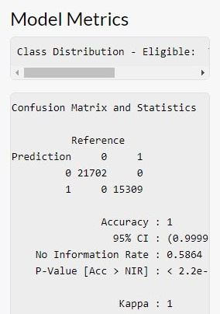
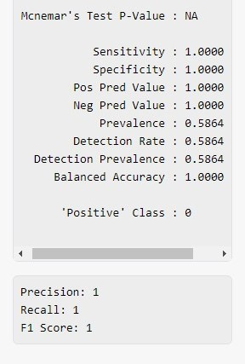
Model Metrics
These metrics help us assess how well the model identifies eligible customers and avoids misclassifications.

Slide 17
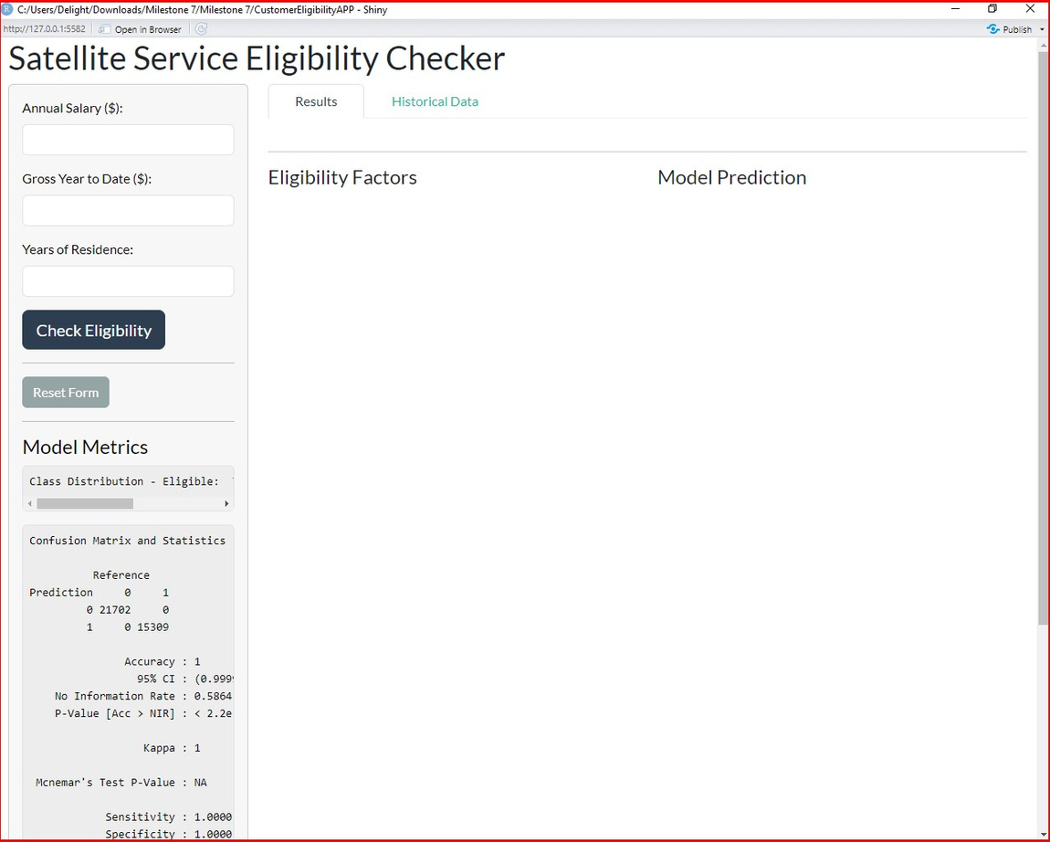
Shiny App UI - User Interaction
Inputs
Buttons
Outputs

Slide 18
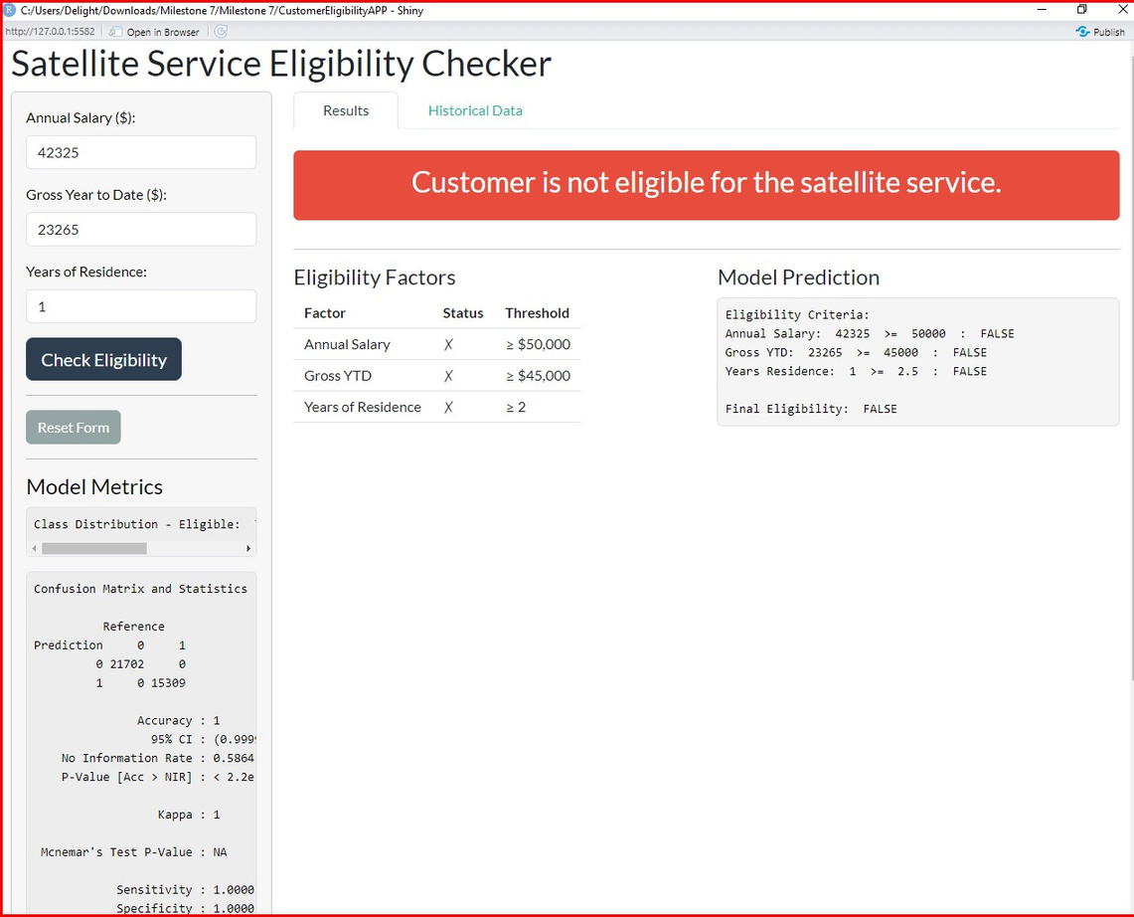
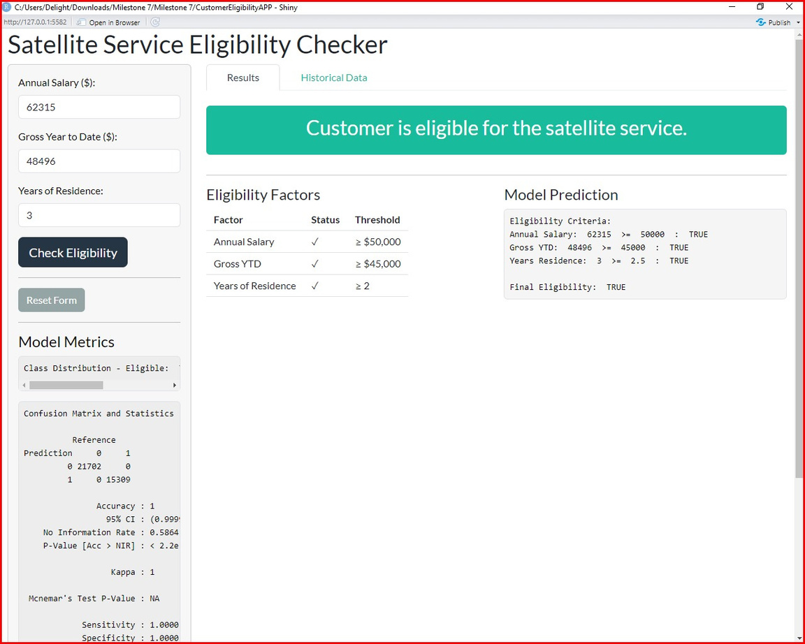
Shiny App UI - User Interaction(continued)
Displays whether the customer meets all eligibility requirements.
Logs previous predictions for user reference.
Shows each factor and if it meets the required threshold.

Slide 19
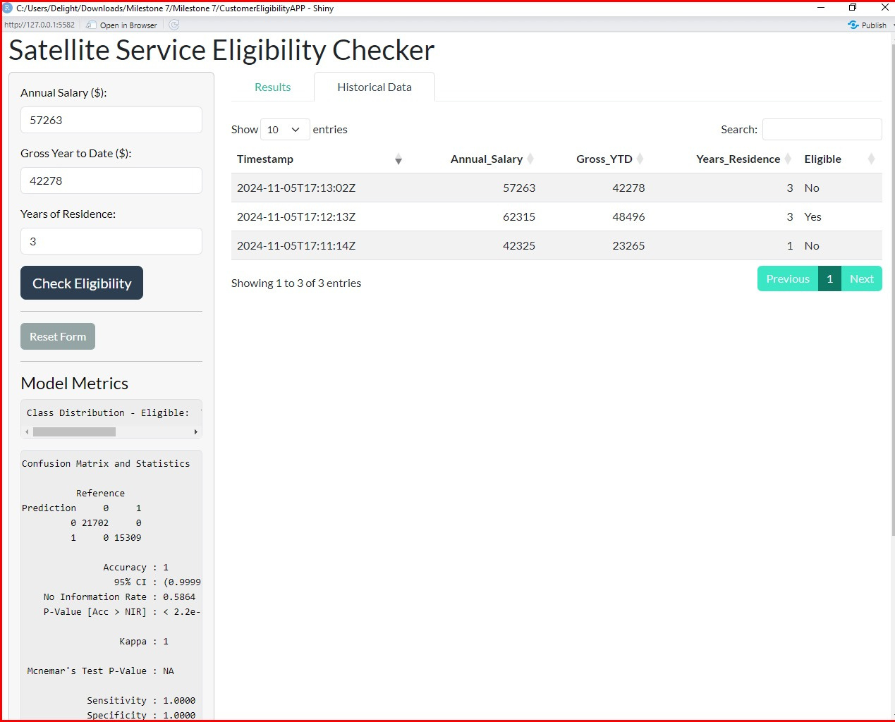
Shiny App UI - User Interaction(continued)
Based on thresholds; each criterion (Salary, YTD, Residence) is checked individually.
Random Forest model makes the final prediction using all three criteria.

Slide 20
Ethical Considerations
Bias Assessment:
Measures taken to minimize bias in eligibility decisions by ensuring diverse training data.
Mitigation Strategies:
Adopted data handling practices to protect sensitive information and ensure fair, accurate predictions.
Compliance Considerations:
Ethical compliance in data usage and secure storage was maintained throughout.

Slide 21
Project review : Lessons Learned
Successes:
Achieved high accuracy, effective CRM integration, and streamlined assessment process.
Challenges:
Data quality issues and balancing model complexity with interpretability.
Areas for Improvement:
Enhancing model interpretability and streamlining data preparation steps.

Slide 22
Learning Experience
Knowledge Gained:
In-depth understanding of machine learning, data processing, and CRM integration.
Skill Development:
Strengthened skills in data science, R programming, and project management.
Future Application:
The model provides a foundation for future projects, including customer segmentation and predictive analytics.

Slide 23
Conclusion and Recommendations
Project Summary:
Successful implementation of a high-performing eligibility model for LangaSat.
Key Findings:
Incorporating multiple variables enhances assessment accuracy, providing robust insights.
Future Recommendations:
Regular model updates, enhanced interpretability, and expansion to other services.

